Slide 1
Dr.SNS RAJALAKSHMI COLLEGE OF ARTS AND SCIENCE (AUTONOMOUS) COIMBATORE-641049 Accredited by NAAC(Cycle III) with “A+” Grade Recognised by UGC, Approved by AICTE, New Delhi and Affiliated to Bharathiar University, Coimbatore.
DEPARTMENT OF COMPUTER SCIENCE
18UCS810: MOBILE APPLICATION DEVELOPMENT(Blended)
III YEAR - V SEM
UNIT 5– TELEPHONY SERVICES
TOPIC – Making Calls and Message Communication

Slide 2
OUTLINE
How to make a call
Lay Out the Screen
Modify the MainActivity Class
Monitoring Phone Call Events
Listening to the Phone Call State
Monitoring Phone Call Events in the Background
Sending SMS Messages
Receiving an SMS Message

Slide 3
How to make a call
To start off, I'll show you how to initiate a call from your application either by using the phone dialer app or directly from your app to make it easier for your users.
Create a New Android Studio Project
Fire up Android Studio and create a new project with an empty activity called MainActivity.

Slide 4
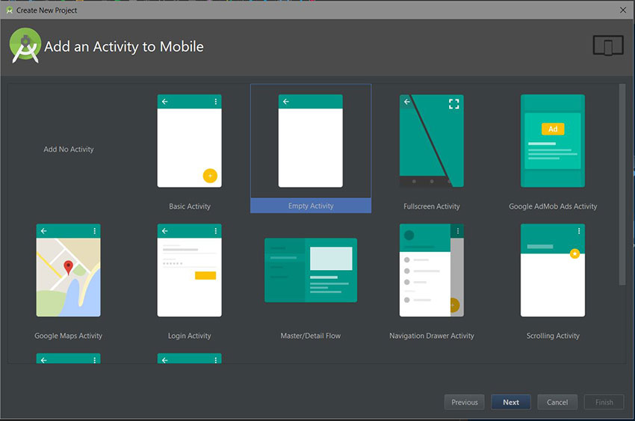
Contd..

Slide 5
Lay Out the Screen
For now, our layout will just have an EditText field and a Dial button:
<?xml version="1.0" encoding="utf-8"?>
<LinearLayout
xmlns:android="https://schemas.android.com/apk/res/android"
xmlns:tools="http://schemas.android.com/tools"
android:id="@+id/activity_main"
android:orientation="vertical"
android:layout_width="match_parent"
android:layout_height="match_parent"
android:paddingLeft="@dimen/activity_horizontal_margin"
android:paddingRight="@dimen/activity_horizontal_margin"
android:paddingTop="@dimen/activity_vertical_margin"
android:paddingBottom="@dimen/activity_vertical_margin"
android:gravity="center_horizontal|center_vertical"
tools:context="com.chikeandroid.tutsplust_telephony.MainActivity">

Slide 6
Contd..
<EditText
android:id="@+id/et_phone_no"
android:hint="Enter Phone number"
android:inputType="phone"
android:layout_width="match_parent"
android:layout_height="wrap_content"/>
<Button
android:id="@+id/btn_dial"
android:layout_gravity="center_horizontal"
android:text="Dial"
android:layout_width="wrap_content"
android:layout_height="wrap_content"/>
</LinearLayout>

Slide 7
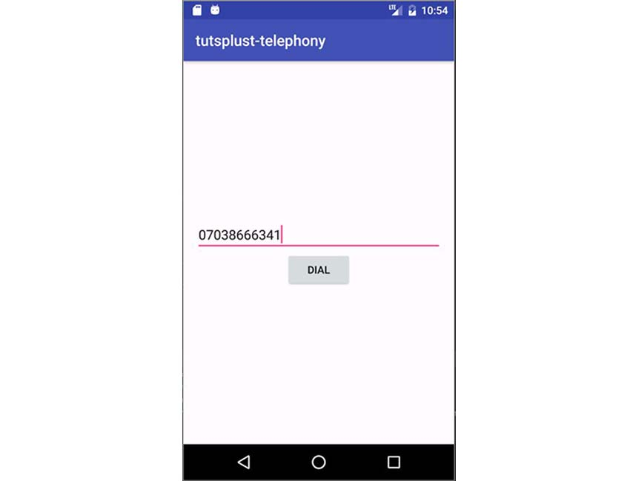
Layout Design panel
SNS DESIGN THINKERS/ Dr.SNSRCAS / CS / 18UCS810-Mobile Application Development/UNIT-3/ Ms R.SARANYA

Slide 8
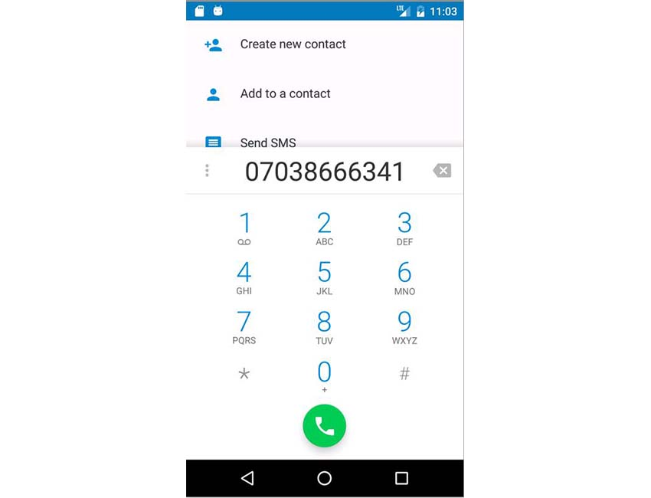
Modify the MainActivity class

Slide 9
Monitoring Phone Call Events
In this section, we are going to learn how to monitor phone call events in the Android system. The phone can be in three states:
idle (when it is unused)
ringing (when there is an incoming call)
off-hook (when the call is answered)

Slide 10
Add the Permission
We need the permission READ_PHONE_STATE to be able to monitor the phone state. Add it to AndroidManifest.xml:
<uses-permission android:name="android.permission.READ_PHONE_STATE"/>

Slide 11
Contd..
PhoneStateListener mPhoneStateListener = new PhoneStateListener() {
……………………..
…………………….
switch (state) {
case TelephonyManager.CALL_STATE_IDLE:
Toast.makeText(MainActivity.this, "CALL_STATE_IDLE", Toast.LENGTH_SHORT).show();
break;
case TelephonyManager.CALL_STATE_RINGING:
Toast.makeText(MainActivity.this, "CALL_STATE_RINGING", Toast.LENGTH_SHORT).show();
break;
case TelephonyManager.CALL_STATE_OFFHOOK:
Toast.makeText(MainActivity.this, "CALL_STATE_OFFHOOK", Toast.LENGTH_SHORT).show();
break; } }
…………

Slide 12
Listening to the Phone Call State
In order to begin listening to the phone call state, we need to get the TelephonyManager from the system service and initialize it in onCreate().
private TelephonyManager mTelephonyManager;
@Override
protected void onCreate(Bundle savedInstanceState) {
// ...
mTelephonyManager = (TelephonyManager) getSystemService(getApplicationContext().TELEPHONY_SERVICE);
}

Slide 13
contd
In the onResume() method, we can begin to listen using the TelephonyManager listen() method, passing it the PhoneStateListener
instance and the static LISTEN_CALL_STATE. We stop listening in the onStop() method by passing the LISTEN_NONE as the second argument to listen().

Slide 14
How to Use the Emulator to Make Calls and Send SMS Messages
You can use your emulator to simulate making a call or sending an SMS message, but you'll need to do a little setup. Open your emulator, click the last button on the right-side navigation bar to open the extended control dialog, and then select the phone control button.

Slide 15
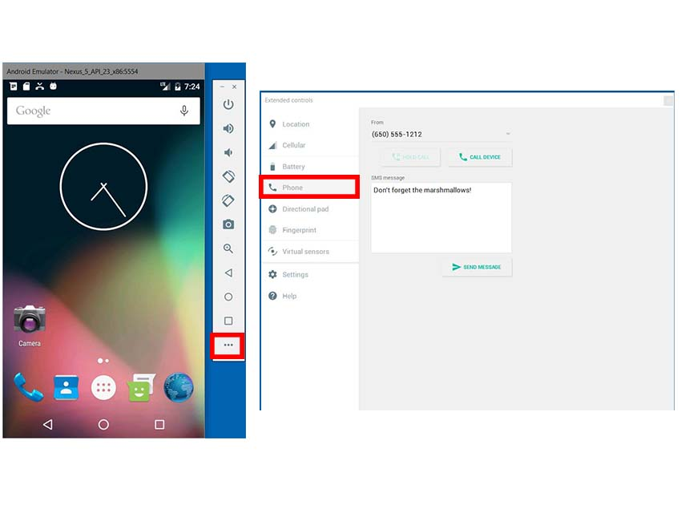
Contd..

Slide 16
How to Use the Emulator to Make Calls and Send SMS Messages
You can use your emulator to simulate making a call or sending an SMS message, but you'll need to do a little setup. Open your emulator, click the last button on the right-side navigation bar to open the extended control dialog, and then select the phone control button.

Slide 17
Monitoring Phone Call Events in the Background
Create a BroadcastReceiver
Just like in the previous section, we need to create an event listener to monitor phone state changes. The major difference is that this time we'll extend the BroadcastReceiver base class so we can listen for the phone call state even if the application is not running.
Modify AndroidManifest.xml
A broadcast receiver works only if it is registered. We need to tell the Android system about our broadcast receiver by registering it in the AndroidManifest.xml file by connecting our PhoneCallStateReceiver class to the <intent-filter> that describes the system broadcast we wish to receive—in this case, PHONE_STATE.

Slide 18
How to Use the Emulator to Make Calls and Send SMS Messages
You can use your emulator to simulate making a call or sending an SMS message, but you'll need to do a little setup. Open your emulator, click the last button on the right-side navigation bar to open the extended control dialog, and then select the phone control button.

Slide 19
Contd..
<receiver android:name=".PhoneCallStateReceiver">
<intent-filter>
<actionandroid:name="android.intent.action.PHONE_STATE"/>
</intent-filter>
</receiver>
Monitoring Outgoing Calls
For outgoing calls, you need to include the NEW_OUTGOING_CALL action intent <action android:name="android.intent.action.NEW_OUTGOING_CALL"/> in the <intent-filter> of the receiver in AndroidManifest.xml.

Slide 20
Contd..
To get the phone number of the intended outgoing call, inside the onReceive(Context, Intent) method, we get the number from the intent as an extra. To prevent that intended call from going through, we can call setResultData() and pass it a null argument. The resultData is used as the actual number to call.
public void onReceive(final Context context, Intent intent) {
// for outgoing call
String outgoingPhoneNo = intent.getStringExtra(Intent.EXTRA_PHONE_NUMBER).toString();
// prevent outgoing call
setResultData(null);
}

Slide 21
Sending SMS Messages
You have just two major choices for sending SMS:
using the device SMS client application
skipping the client by sending the SMS directly from your app.

Slide 22
Set Up the Layout
First, we need to modify our main layout to have an EditText field for the message and a Send Message button.
<EditText
android:id="@+id/et_message"
android:hint="Enter message"
android:inputType="textCapSentences|textMultiLine"
android:maxLength="2000"
android:maxLines="12"
android:layout_width="match_parent"
android:layout_height="wrap_content"/>
<Button
android:id="@+id/btn_send_message"
android:layout_gravity="center_horizontal"
android:text="Send Messange"
android:layout_width="wrap_content"
android:layout_height="wrap_content"/>
<!--/ ... /-->

Slide 23
Modify the MainActivity
Inside our onCreate() method in our MainActivity class, create an intent with ACTION_SENDTO as the first argument and a smsto:<phone number> The text message will be the value of the sms_body extra:

Slide 24
Modify the MainActivity Contd..
Button sendMessageBtn = (Button) findViewById(R.id.btn_send_message);
final EditText messagetEt = (EditText) findViewById(R.id.et_message);
sendMessageBtn.setOnClickListener(new View.OnClickListener() {
@Override
public void onClick(View view) {
String message = messagetEt.getText().toString();
String phoneNo = mPhoneNoEt.getText().toString();
if(!TextUtils.isEmpty(message) && !TextUtils.isEmpty(phoneNo)) {
Intent smsIntent = new Intent(Intent.ACTION_SENDTO, Uri.parse("smsto:" + phoneNo));
smsIntent.putExtra("sms_body", message);
startActivity(smsIntent);
}
}
});

Slide 25
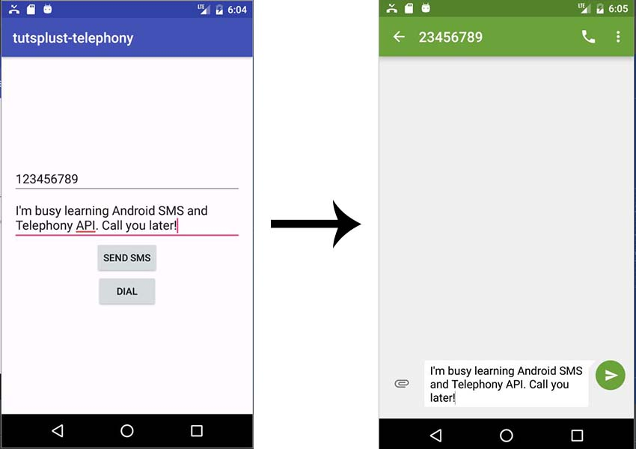
Contd..
Here, the SMS client will monitor the status of the message delivery. Run the App When all required fields are
entered, clicking the Send SMS
button will open the user's
SMS client, or will give the user
options to select an app if one
hasn't already been chosen.

Slide 26
Sending SMS Messages Directly
Add Permission in AndroidManifest.xml As usual, we need to register the permission inAndroidManifest.xml.
<uses-permission android:name="android.permission.SEND_SMS"/>
Modify the MainActivity class
Next, for Android 6.0 and above, we need to request the SEND_SMS permission during runtime.

Slide 27
Modify the MainActivity
Inside our onCreate() method in our MainActivity class, create an intent with ACTION_SENDTO as the first argument and a smsto:<phone number> The text message will be the value of the sms_body extra:

Slide 28
Modify the MainActivity
If you want to use sentIntent, watch for the result code Activity.RESULT_OK on success, or one of RESULT_ERROR_GENERIC_FAILURE, RESULT_ERROR_RADIO_OFF, and RESULT_ERROR_NULL_PDU to indicate an error.
To send an SMS, we get the default SmsManager instance and then call its sendTextMessage() method, passing in the phone number as the first argument and the message as the second argument:
To monitor the status of delivery, the SMSManager sendTextMessage() method has two optional PendingIntent parameters: sentIntent and deliveryIntent.
void sendTextMessage (String destinationAddress,
String scAddress,
String text,
PendingIntent sentIntent,
PendingIntent deliveryIntent)

Slide 29
Modify the MainActivity
Inside our onCreate() method in our MainActivity class, create an intent with ACTION_SENDTO as the first argument and a smsto:<phone number> The text message will be the value of the sms_body extra:

Slide 30
Contd..
If you want to use sentIntent, watch for the result code Activity.RESULT_OK on success, or one of RESULT_ERROR_GENERIC_FAILURE, RESULT_ERROR_RADIO_OFF, and RESULT_ERROR_NULL_PDU to indicate an error.
Receiving an SMS Message
For your app to begin receiving SMS messages from the user's phone, its best to have a broadcast receiver registered so that it can be alerted when a new SMS arrives even if your app is not running in the foreground.

Slide 31
Add the Permission
Next, we need to check and see if the app has permission to receive SMS messages at runtime. So in the MainActivity class, check for the RECEIVE_SMS permission. If it is not found, request it.
protected void onCreate(Bundle savedInstanceState) {
// ...
if(!checkPermission(Manifest.permission.RECEIVE_SMS)) {
ActivityCompat.requestPermissions(this, new String[]{Manifest.permission.RECEIVE_SMS}, 222);
}
}
// ...
Add the RECEIVE_SMS permission to AndroidManifest.xml:
<uses-permission android:name="android.permission.RECEIVE_SMS"/>

Slide 32
Create a Broadcast Receiver
We are retrieving each object of the SmsMessage class by using the method createFromPdu(byte[] pdu), passing it a PDU (protocol data unit). We are then adding it to our messages array..
Now, run the app, close it, and send your emulated phone an SMS.

